Slide 4


Slide 5




Slide 7


Slide 8

How did we choose our final design?

Slide 9


Slide 12

Economic Analysis

Slide 13


Slide 14
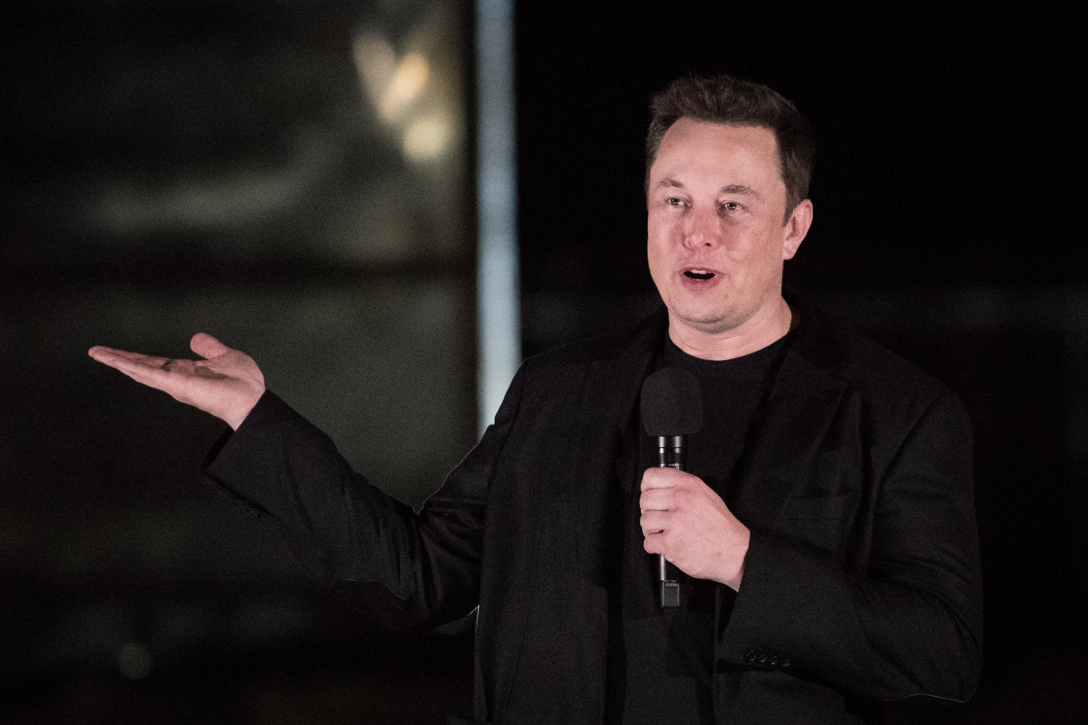
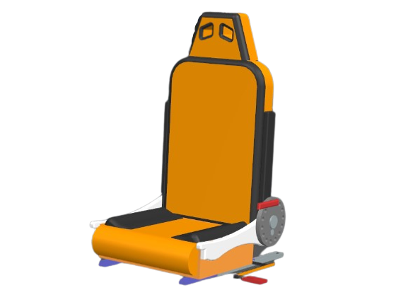
The End
Notes:
ELON MUSK APPROVED
Thank you for listening.

